Slide 1
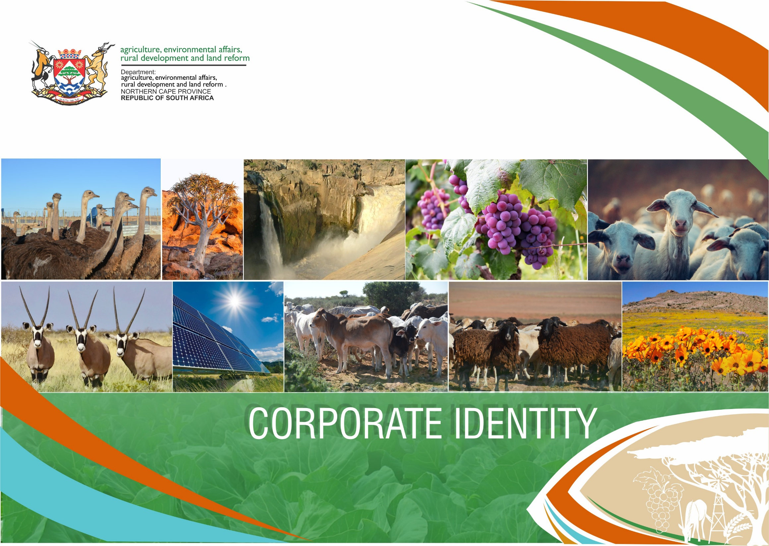
CORPORATE IDENTITY

Slide 2
BACKGROUND
Following the National Elections of 2019, The Premier announced that the Department of Environment and Nature Conservation will be merged with the Department of Agriculture, Land Reform and Rural Development.
The determining Proclamation 16 of 2020 to establish the new Department came into effect from the 01 April 2020. The merged Department is now known as the
: Department of Agriculture, Environmental Affairs, Rural Development and Land Reform.
PURPOSE
The former departments had their own identities, therefore is a need to merge the two identities to represent the mandate of the established department. In developing this CI Manual common identities of the former departments and what is prevalent in the Province was taken into account.
WHAT IS A CI MANUAL
It is a document which represent the overall face of an organization using the visual elements from logos to font and colours. It is also noticeable in physical form like in stationery, uniforms, merchandise, brochures or online campaigns.

Slide 3
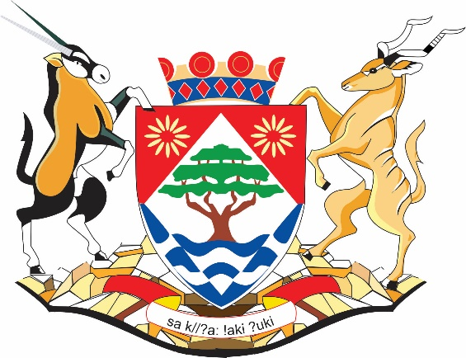
THE STARTING POINT IN DEVELOPING THE CI MANUAL IS THE NORTHERN CAPE COAT OF ARMS
THE NORTHERN CAPE COAT OF ARMS
Diamond shape
Diamonds, the province's mineral wealth.
Waves:
The two great rivers that flow through the Province. Our life line-blood and sustenance.
Tree:
A Camelthorn, the most common tree in the Northern Cape. A symbol of life and growth.
Yellow Flowers:
Namakwa daisies, a symbolic of natural beauty of the Province.
Red Triangles:
The colour of the soil on the Northern Cape and also the Sun.
Supporters:
The Gemsbok and the Kudu are the most prevelant large antelopes in the Northern Cape.
Base:
The brown and rocky base is the desert environment of the Northern Cape.
The Crest:
The beadwork crown is inspired by the San/Bushman beadwork and is in fact an inverted traditional headdress.
The Motto:
Translated to mean Strive for a better life.
It is written in the !Auni language of the Khomani San the last indigenous San people of South Africa and was given to us by one of the last speakers of the language, Ms Elsie Vaalbooi of Rietfontein who has since passed away.
Pre-dating the National motto which is written in the extinct !Xam language, it was the first officially registered motto in the history of our country to be in a KhoeSan language.

Slide 4
THE CORPORATE IDENTITY MANUAL
Serves as a guide to using elements associated with the Department,
Provides information to ensure compliance and consistency in using the Departments approved identity
It outlines the branding elements that are permissible in branding and how the corporate identity is to be applied to achieve the desired image.
Ensure quality control in promotional and communication materials developed
Ensure that Government branding guidelines are followed correctly as per GCIS booklet
THE ELEMENTS OF THE CORPORATE IDENTITY MANUAL
The proposed document comprises of the following elements: Logo, Colours, Camel thorn tree, Gemsbok, wheat and land/sea and infrastructure.
which will appear in material produced by the Department.

Slide 5
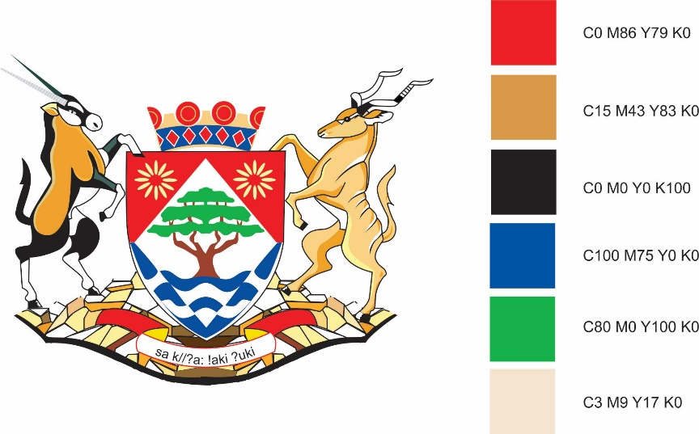
THE DEPARTMENTAL LOGO
There are primary colours of the Coat of arms selected for use by the department: Green, brown and blue.
Font
Gill sans and Arial

Slide 6
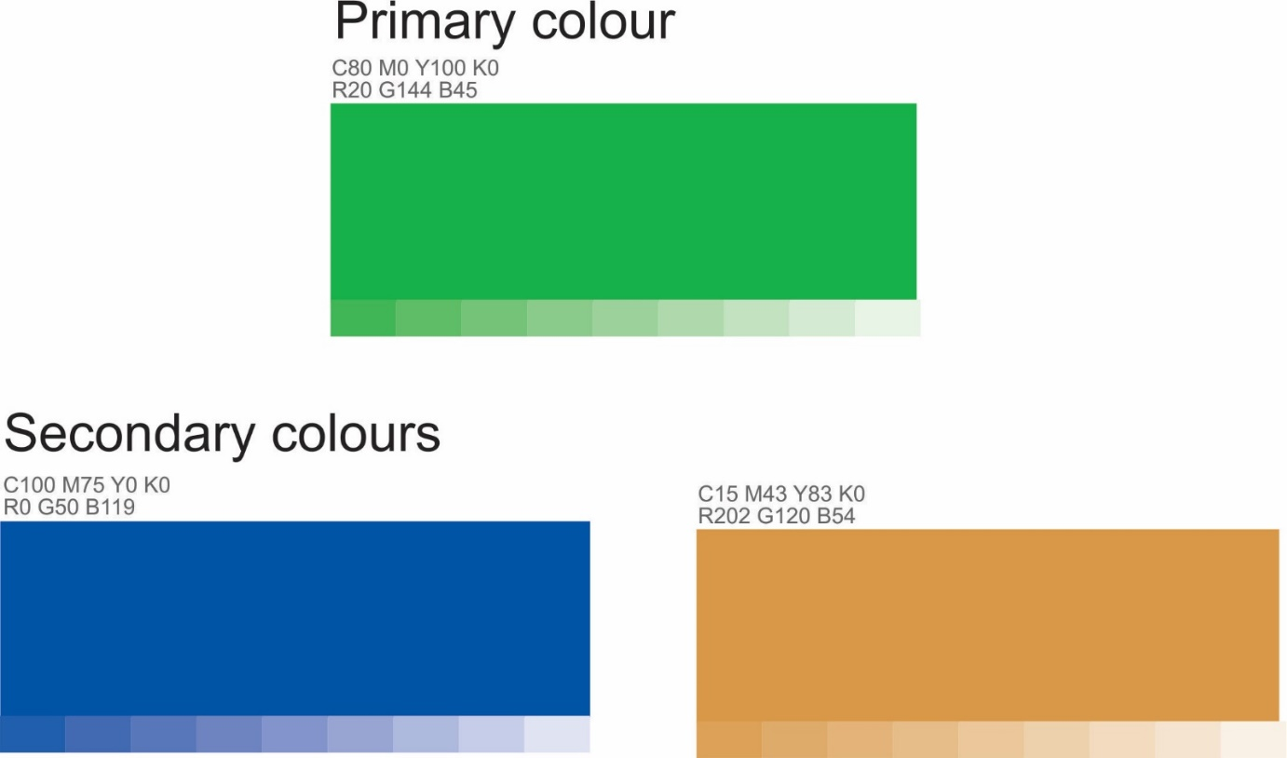
SELECTED COLOURS FOR CI MANAUAL

Slide 7
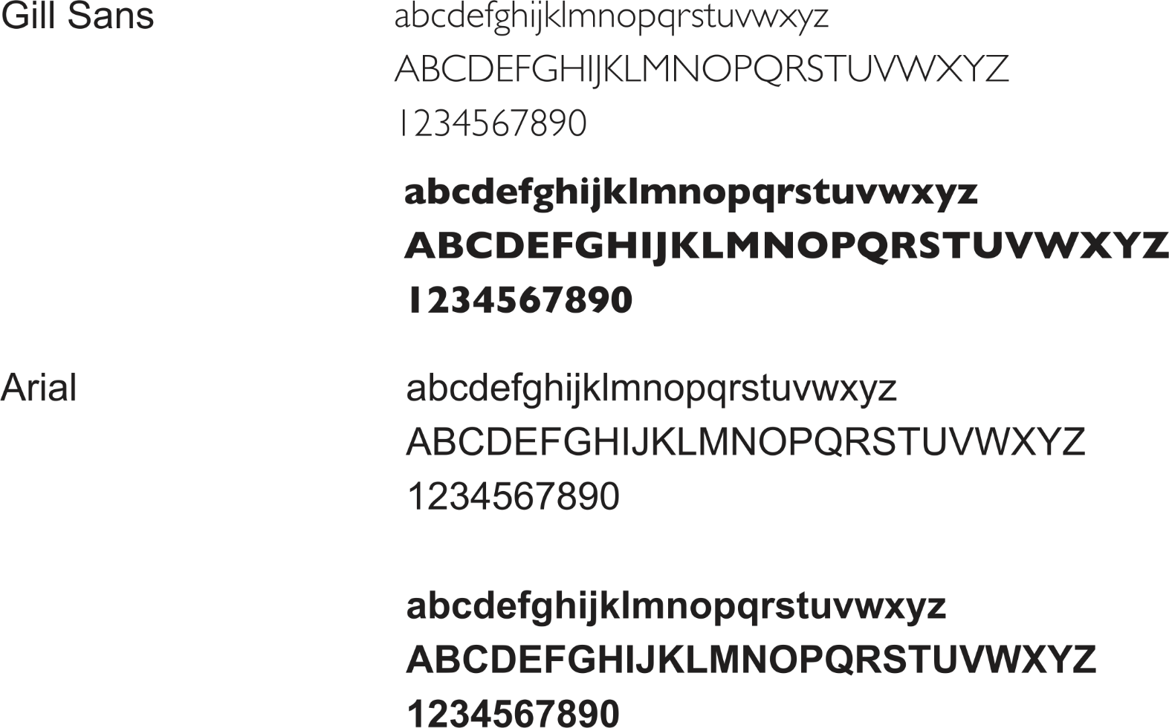
FONTS

Slide 8
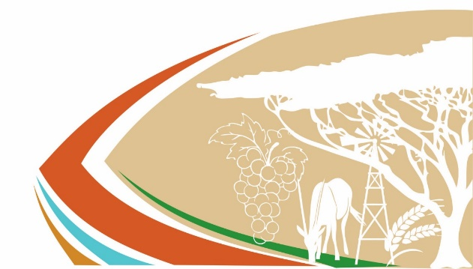
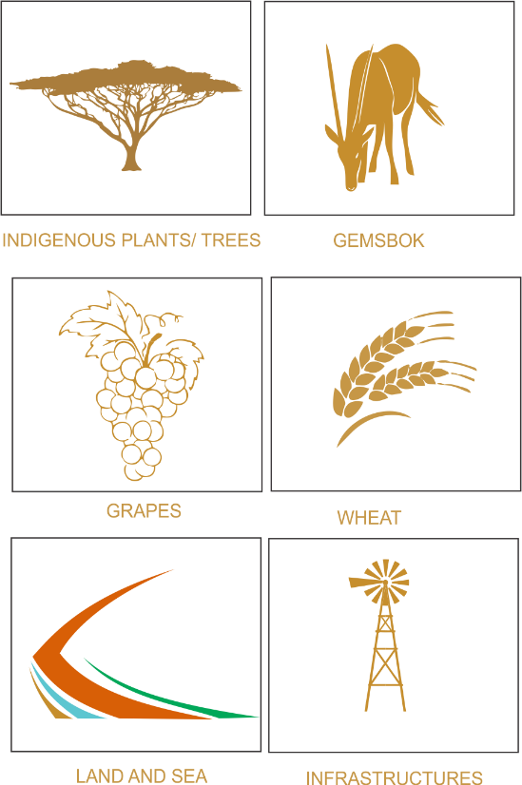
ELEMENTS IN DESIGN
Camel Thorn tree
It is protected under the national Forest Act also part of the Kalahari Protected Woodland.
It is commonly found in the Northern Cape.
Plays an important role in the ecosystem : a keystone species as it sustains a myriad of other life forms, without it the ecosystem would be dramatically different or even cease to exist”
Its pods are used for nutritional value as feed for animals
Preferred firewood by humans
Gemsbok
It is commonly found in all the reserves managed by the Department
It can withstand and adapt to arid harsh regions
It has a reassuring nature
Grapes
Reports indicates that the grape industry continues to grows in the Northern
Cape. The current estimates for the Northern Cape are sitting at a high of 78 000 tonnes of marketable grapes.
Wheat
Is one of the main variety of crops grown in the province, a cereal grain which is a worldwide staple food. Reports shows that the province contributes 17% to the total productions of South Africa.
Land and Coastal Management
Shades represent
The Brown - Land /Soil- Environment
The Green - Agriculture and Conservation
The Blue - Coastal Management
Infrastructure
The province is a water scares province and the department commonly use infrastructure to assist farmers and animals to get their water.

Slide 9
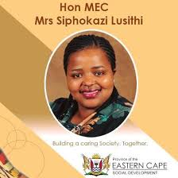
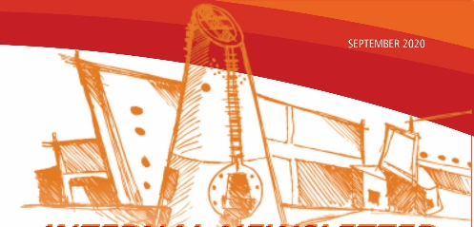
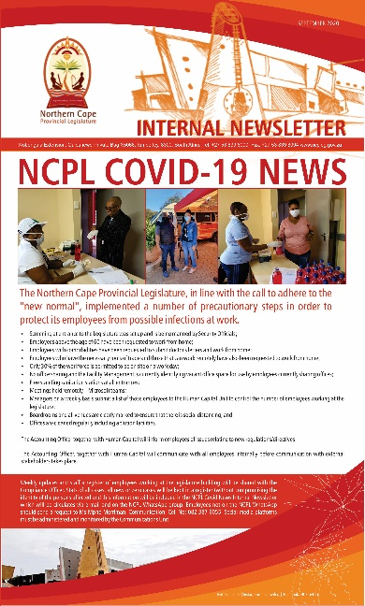
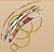
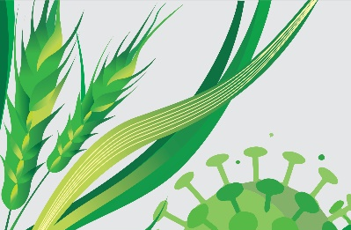
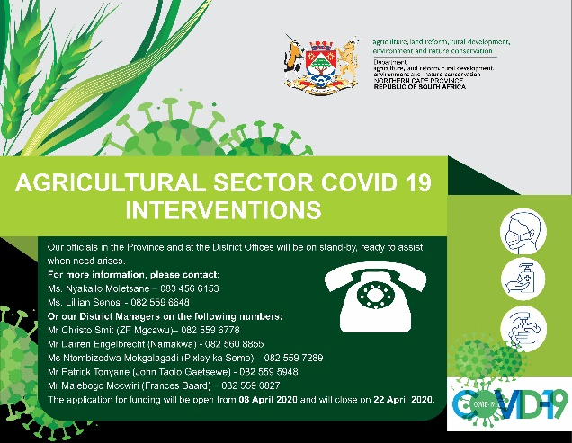
ELEMENTS DESIGN FROM OTHER DEPARTMENTS

Slide 10
Inputs received summary
To use elements of products mostly found in the Northern Cape
Approve use of the Camelthorn tree
Approve use of the Gemsbok
Incorporate grape watermark

Slide 11
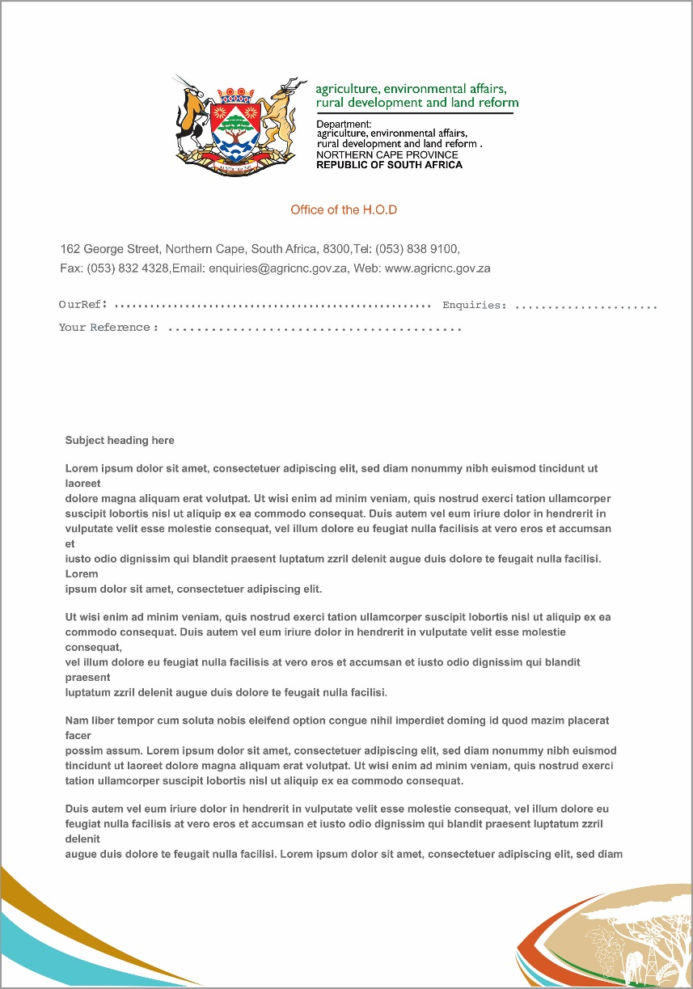
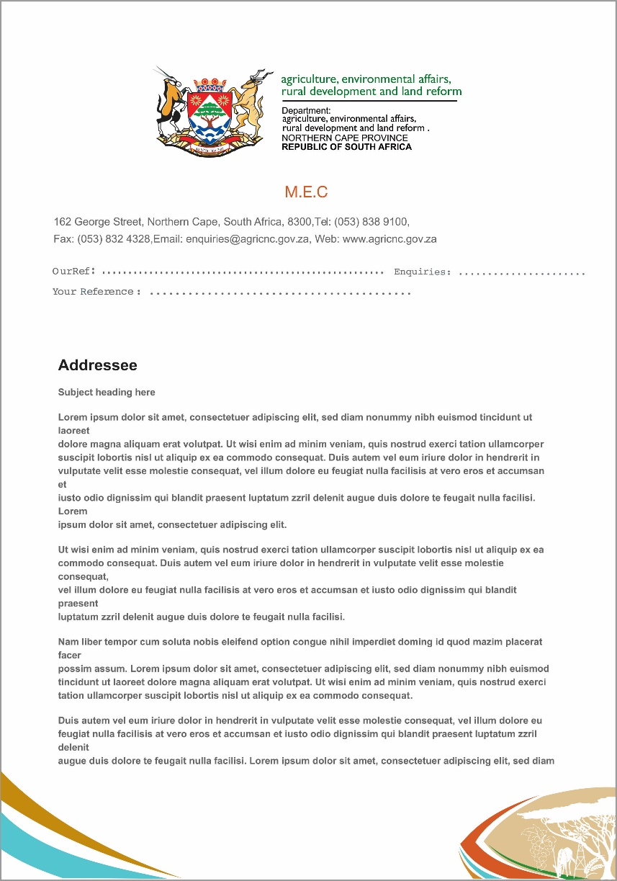
LAYOUT OF DOCUMENTS / LETTERHEADS

Slide 12
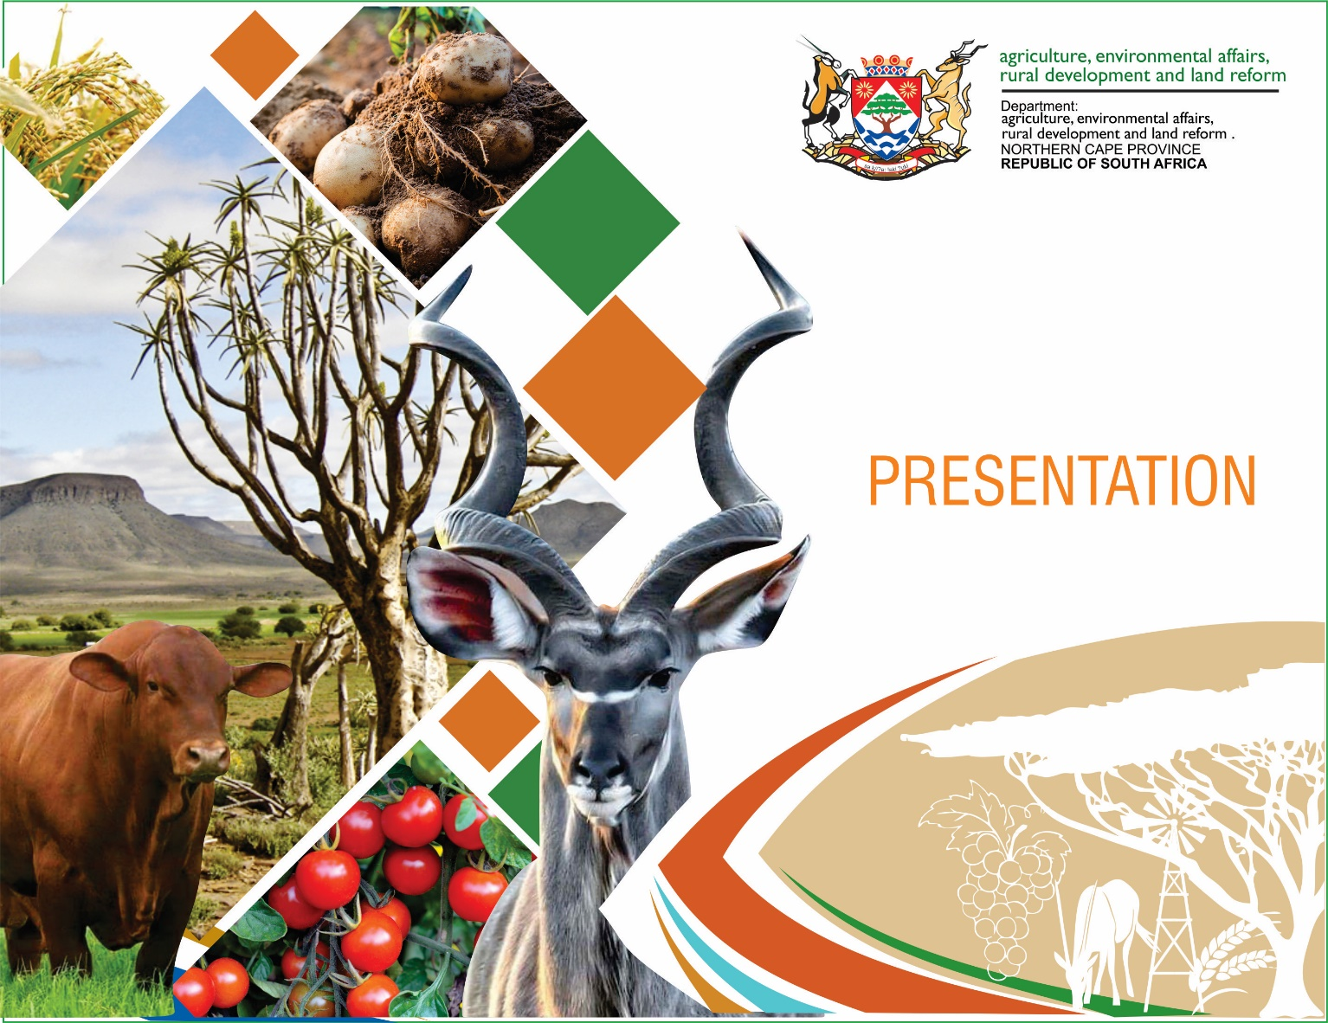
EXAMPLE OF PRESENTATION LAYOUT

Slide 13
Thank you

